Slide 1
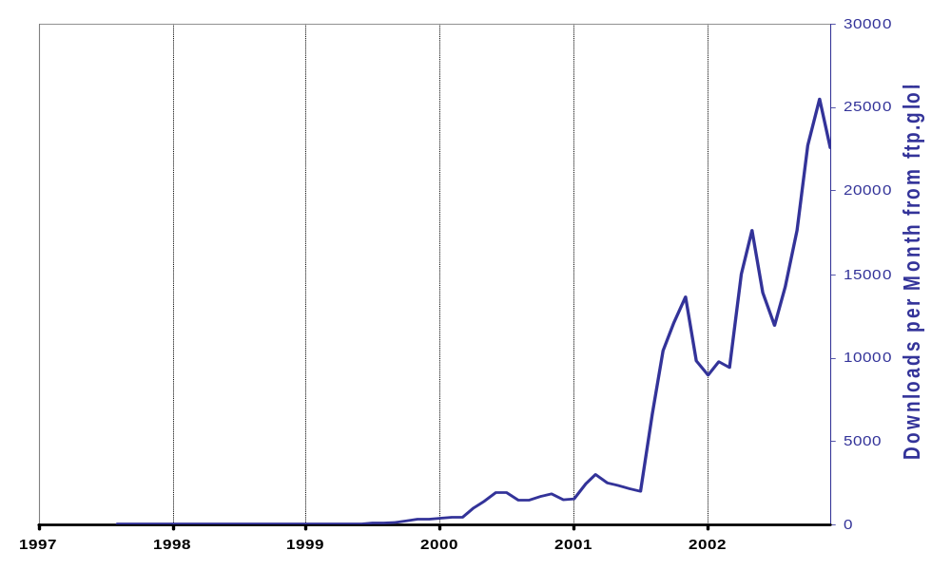
Globus Toolkit® History
Does not include downloads from:
NMI, UK eScience, EU Datagrid,
IBM, Platform, etc.
GT 2.0
Released
Physiology of the Grid
Paper Released
Anatomy of the Grid
Paper Released
Significant
Commercial
Interest in
Grids
The Grid: Blueprint for a
New Computing
Infrastructure published
NSF & European Commission
Initiate Many New Grid Projects
DARPA, NSF, and DOE begin funding Grid work
Early Application
Successes Reported
GT 1.0.0
Released
NASA begins
funding Grid work,
DOE adds support

Slide 2
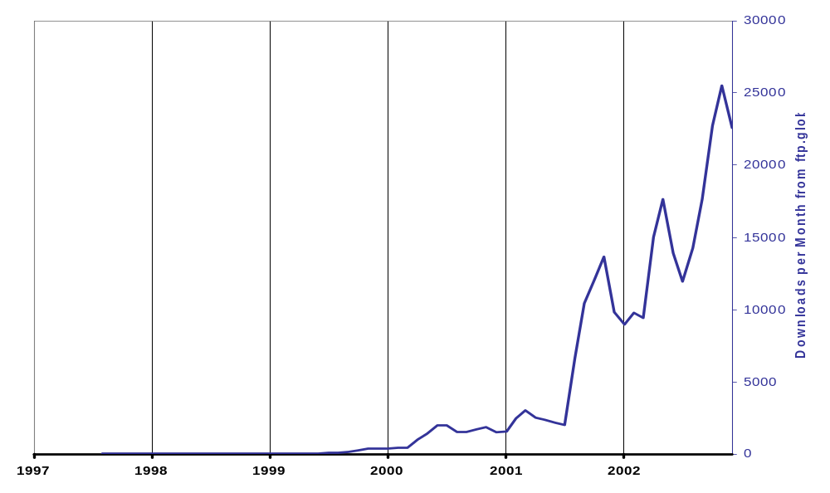
Globus Toolkit® History
Does not include downloads from:
NMI, UK eScience, EU Datagrid,
IBM, Platform, etc.
GT 2.0
Released
GT 2.2
Released
Physiology of the Grid
Paper Released
GT 2.0 beta
Released
NSF GRIDS Center
Initiated, DOE begins
SciDAC program
Anatomy of the Grid
Paper Released
GT 1.1.4 and
MPICH-G2 Released
Significant
Commercial
Interest in
Grids
The Grid: Blueprint for a New Computing
Infrastructure published
NSF & European Commission
Initiate Many New Grid Projects
First
EuroGlobus
Conference
Held in
Lecce
DARPA, NSF, and DOE begin funding Grid work
GT 1.1.3
Released
MPICH-G
released
Globus Project wins
Global Information Infrastructure
Award
Early Application
Successes Reported
GT 1.1.2
Released
GT 1.0.0
Released
GT 1.1.1
Released
NASA initiates
Information Power Grid,
DOE increases support

